Slide 1
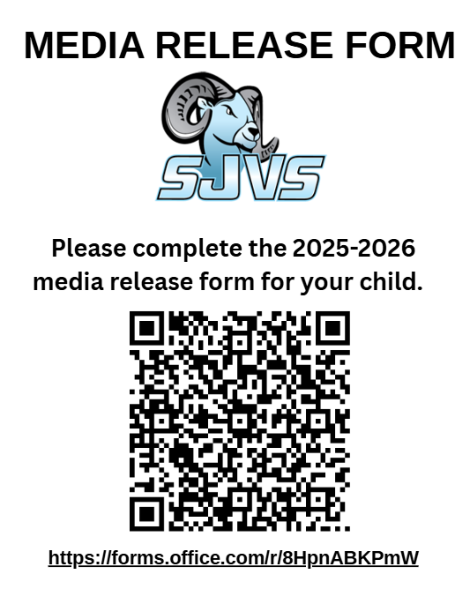
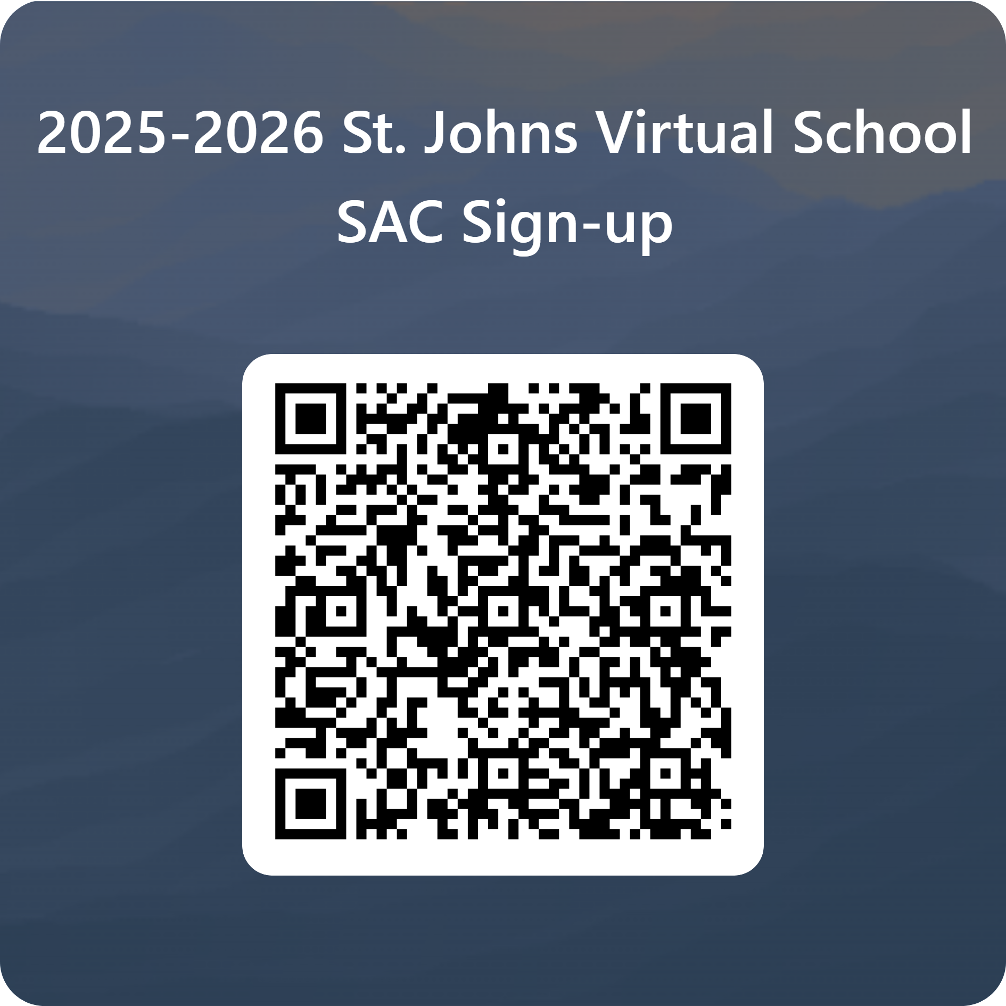

Slide 2

Welcome Back Rams!
2025-2026
Dr. Lindsey Page

Slide 3
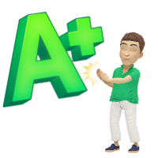
SJVS is an A-Rated School!!!!

Slide 4

We are a Program of Choice
SJVS is a public school located in St. Johns County
All teachers are highly effective instructors and are employed by St. Johns County School District
Our Mascot is the RAM
Our main building is located on the First Coast Technical College Campus
We use Florida Virtual School curriculum
Some Common Questions
  We are not FLVS, SJVS uses their curriculum, but provides the instructors
  Full-time SJVS is not Home Education

Slide 5
Technology
SJVS does not provide computers, printers, or internet.
Best practice is for all students in our program to have their own computer
MacBook or PC both are compatible
Chrome, Firefox or Apple Safari are recommended browsers
iPad, Chromebook, and tablets tend to have limitations if a course has JAVA, Flash, etc.

Slide 6
Basic Supplies for Success
Computer
Printer
Binder
Writing tools
Highlighters
Index Cards
USB

Slide 7


Expectations for
2025-2026

Slide 8
Required
Work each week and stay on or ahead of pace in each course (7% weekly)
Come In for ALL state assessments (all are in person at SJVS campus)
If receiving additional services (ESE, RTI, RAMJAM), must attend all of these
Monthly Homeroom

Slide 9
Optional (but highly recommended)
Attend weekly Live Teacher Time
All students receiving interventions (IEP, RTI are required to attend each week)
*Please note that if in Intensive Reading, this is required each week. This earns a grade
Come on Campus for Enrichment Days/Field Studies

Slide 10

Florida’s Assessment of Student Thinking (F.A.S.T.)

Slide 11
Test Resources
Students and Families Resource Website - https://flfast.org/families.html
Practice Test - https://login4.cambiumtds.com/student_core/V87/Pages/LoginShell.aspx?c=Florida_PT&a=Student
Testing Fact Sheet - https://www.fldoe.org/core/fileparse.php/20102/urlt/2324FASTGrd310FS.pdf
EOC Computer-Adaptive Testing
  Video - https://files.portal.cambiumast.com/florida/Media/FLCAT/FLCAT.html
  Facts - https://www.fldoe.org/core/fileparse.php/20102/urlt/CompAdaptTestFAQ.pdf
Family Link - https://fsassessments.org/families.html
  Family Portal - https://fl-familyportal.cambiumast.com/#/
Florida Graduation Requirements - https://www.fldoe.org/core/fileparse.php/7764/urlt/GradRequireFSA.pdf

Slide 12

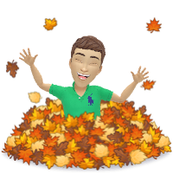

Fall 2025 Testing Dates and Times

Slide 13

Testing – Fall Session (Grade KG-5)
Reading
Monday, August 25, 2025
  1 day session
  Time
    9:30am start
Mathematics
Tuesday, September 2, 2025
  1 day session
  Time
    9:30am start

Slide 14
Testing – Fall Session (Grades 6-8)
Reading
Tuesday, August 26, 2025
  1 day session
  Time
    9:30am start
Mathematics
Thursday, September 4, 2025
  1 day session
  Time
    9:30am start

Slide 15
Testing – Fall Session (Grade 9)
Reading
Thursday, August 28, 2025
  1 day session
  Time
    9:30am start

Slide 16
Testing – Fall Session (Grade 10)
Reading
Friday, August 29, 2025
  1 day session
  Time
    9:30am start

Slide 17
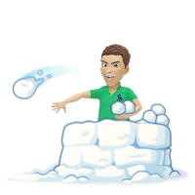
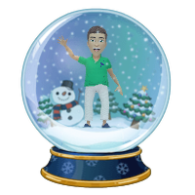
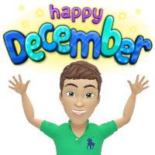
Winter 2025 Testing Dates and Times

Slide 18
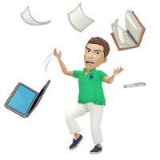
Testing – Winter Session (Grade K-5)
Reading
Monday, December 1, 2025
  1 day session
  Time
    9:30am start
Mathematics
Monday, December 8, 2025
  1 day session
  Time
    9:30am start

Slide 19
Testing – Winter Session (Grades 6-8)
Reading
Tuesday, December 2, 2025
  1 day session
  Time
    9:30am start
Mathematics
Tuesday, December 9, 2025
  1 day session
  Time
    9:30am start

Slide 20
Testing – Winter Session (Grade 9)
Reading
Thursday, December 4, 2025
  1 day session
  Time
    9:30am start

Slide 21
Testing – Winter Session (Grade 10)
Reading
Friday, December 5, 2025
  1 day session
  Time
    9:30am start

Slide 22
Testing – Winter Session (US Gov Students)
Florida Civics Literacy Exam (FCLE)
Thursday, December 11, 2025
  1 day session
  Time
    9:30am start
  For students that took US Government or Dual Enrollment Government course in Fall 2025 and wish to take FCLE now rather than Spring 2026.

Slide 23



Spring 2026 Testing Dates and Times

Slide 24

March/April 2026: Writing
Grades 4&5 Writing March 30, 2026
Grades 6-8 Writing March 31, 2026
Grade 9 Writing April 2, 2026
Grade 10 Writing April 7, 2026

Slide 25

Testing – Spring Session (Grade K-2)
Reading
Monday, April 13, 2026
  1 day session
  Time
    9:30am start
Mathematics
Monday, April 20, 2026
  1 day session
  Time
    9:30am start

Slide 26
Testing – Spring Session (US Gov Students)
Florida Civics Literacy Exam (FCLE)
Tuesday, April 21, 2026
  1 day session
  Time
    9:30am start

Slide 27
Testing – Spring Session (Grade 3-5)
Reading
Monday, May 4, 2026
  1 day session
  Time
    9:30am start
Mathematics
Monday, May 11, 2026
  1 day session
  Time
    9:30am start

Slide 28
Testing – Spring Session (Grades 6-8)
Reading
Tuesday, May 5, 2026
  1 day session
  Time
    9:30am start
Mathematics
Tuesday, May 12, 2026
  1 day session
  Time
    9:30am start

Slide 29
Testing – Spring Session (Grade 9)
Reading
Wednesday, May 7, 2026
  1 day session
  Time
    9:30am start

Slide 30
Testing – Spring Session (Grade 10)
Reading
Friday, May 8, 2026
  1 day session
  Time
    9:30am start

Slide 31
Testing – Spring Session (Science Grades 5&8)
Grade 5&8
Friday, May 1, 2026
  1 day session
  Time
    9:30am start

Slide 32
Testing – Spring Session (Math EOC’s)
Algebra 1
Thursday, May 14, 2026
  1 day session
  Time
    9:30am start
Geometry
Friday, May 15, 2026
  1 day session
  Time
    9:30am start

Slide 33
Testing – Spring Session (Social Studies EOC’s)
US History (High School)
Monday, May 18, 2026
  1 day session
  Time
    9:30am start
M/J Civics
Tuesday, May 19, 2026
  1 day session
  Time
    9:30am start

Slide 34
Testing – Spring Session (Science EOC)
Biology
Wednesday, May 20, 2026
  1 day session
  Time
    9:30am start

Slide 35

Important Dates
2025-2026

Slide 36
Fall 2025 Important Dates
8 Aug.
Orientation/Meet the Teacher (In-person)
9:00 – 12:00pm
11 Aug.
First day of school
19 Sept.
Teacher In-service Day
11 Nov.
Veterans Day
24-28 Nov.
Thanksgiving Break
12 Dec.
Last day to turn in all coursework
1 Sept.
Labor Day
22 Dec.
Winter Breaks begins
12 Dec.
13 Oct.
Sept 26
Enrichment Day: On-Campus
24 Oct.
Enrichment Day: On-Campus
Academic Day
14 Nov.
Enrichment Day: On-Campus
Academic Day
Enrichment Day: On-Campus
Academic Day
Picture Day
Academic Day
Teacher Planning Day

Slide 37
Spring 2026 Important Dates
2 Jan.
Teachers return
5 Jan.
Students return
19 Jan.
MLK Day
13 Feb.
Teacher In-service Day
16 Feb.
Presidents Day
13 March
Teacher Planning Day
16-20 March
Spring Break
6 Feb.
Enrichment Day: On-Campus
1 May
Senior deadline to complete courses
8 May
Last day to turn in all coursework
18 May
Senior Graduation Rehearsal
21 May
Senior Graduation
25 May
Memorial Day
29 May
Last day of school for students
1 June
Last day of school for teachers
9 Jan.
Enrichment Day: On-Campus
Academic Day
6 March
Enrichment Day: On-Campus
Academic Day
10 April
Enrichment Day: On-Campus
Academic Day
3 April
Holiday
12 March
NHS/NJHS Induction
5pm Start

Slide 38
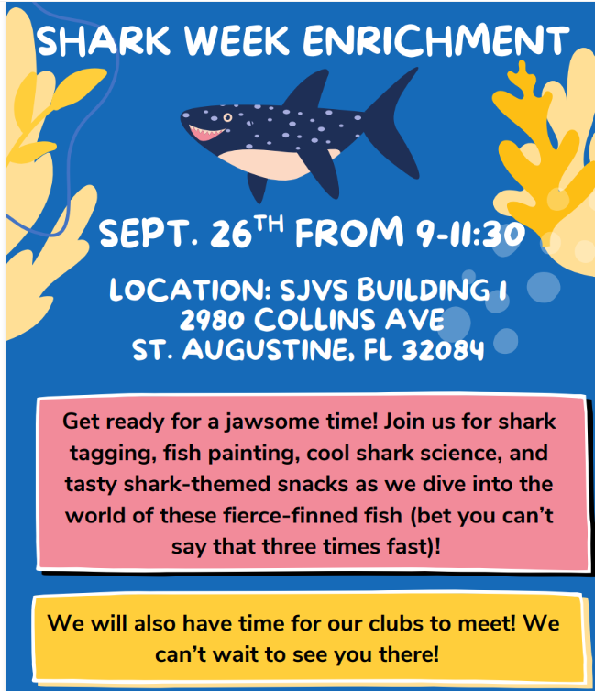
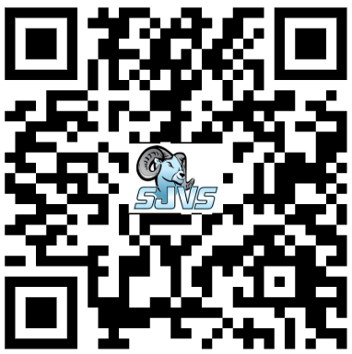
Enrichment Days/On Campus Field Trips
Clubs
On campus
Interactions with teachers and students

Slide 39
RamJams
Targeted
On zoom
Math/ELA/Test Prep

Slide 40
Academic Days
Please note that each month we will monitor student pacing. Any student that is 2 weeks or greater behind pace, will be required to come on campus to work.
Will occur (starting in September)
9:00-11:30am
Other students that are on pace but may need some additional support can also attend.
Teachers will be onsite. Teacher rotation will occur since they will coincide with Enrichment Day activities.

Slide 41

SJVS Website – Ultimate Hub for Info https://stjohnsvirtual.com/

Slide 42
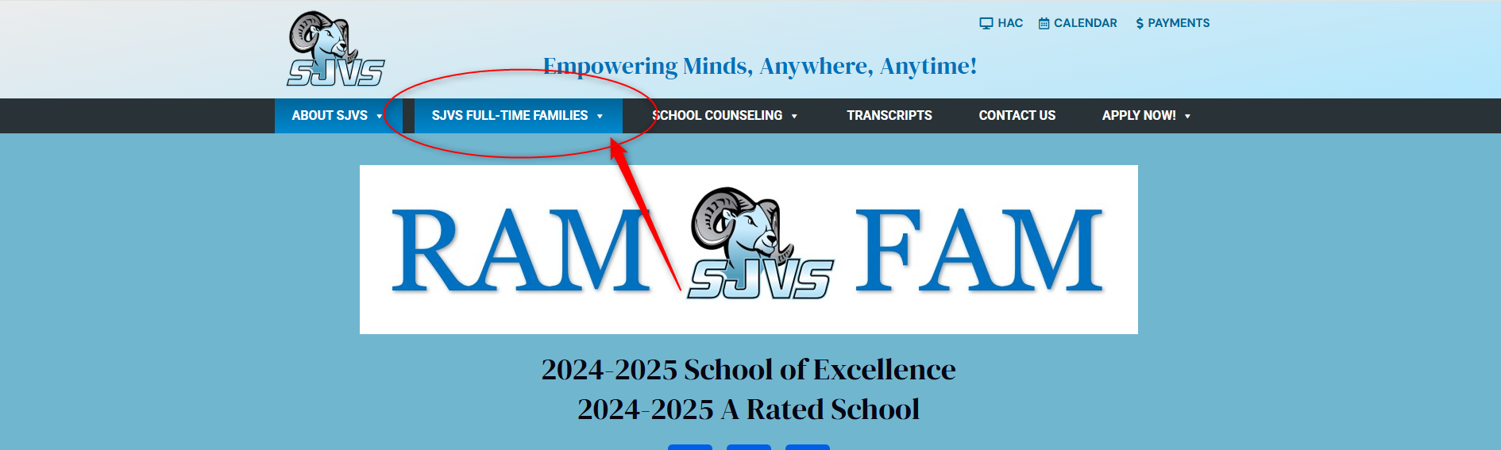
SJVS Website
SJVS Full-time Families Menu
https://stjohnsvirtual.com/

Slide 43
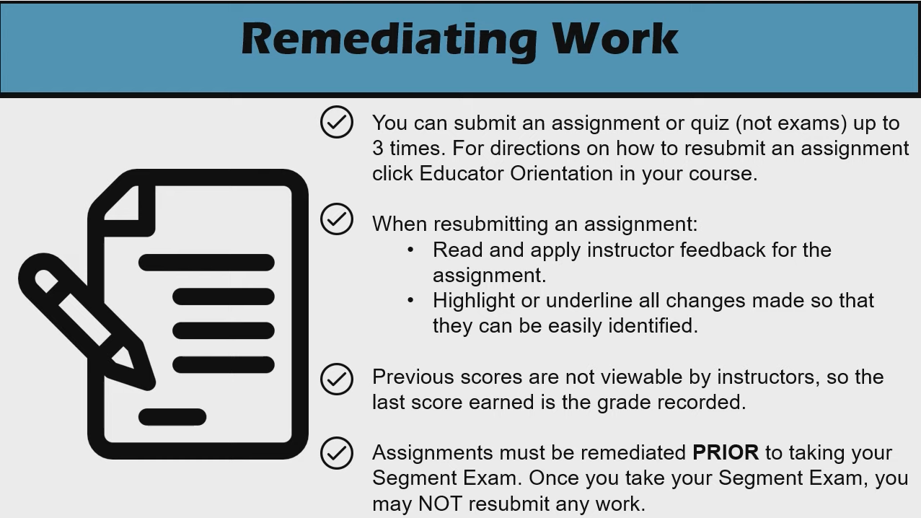
Mastery Based Learning

Slide 44

Pacing
Pacing
Submit assignments on time
  All worked will be graded within 2 school days.
  Essays will have up to five school days to be graded.
Failure to adhere to your pace chart could result in being withdrawn from the course, or full-time program.
A general guide is to complete roughly 7% of each course each week.
  However, please refer to your pace chart for it will reflect accurately whether you are on pace or not.
All coursework is due by 5pm on Fridays.
Completing your segment is a marathon, not a sprint. Pacing yourself will help in completing the race and not falling behind and then thinking you can turn all assignments in at the end. This is not what this program is meant to be.

Slide 45
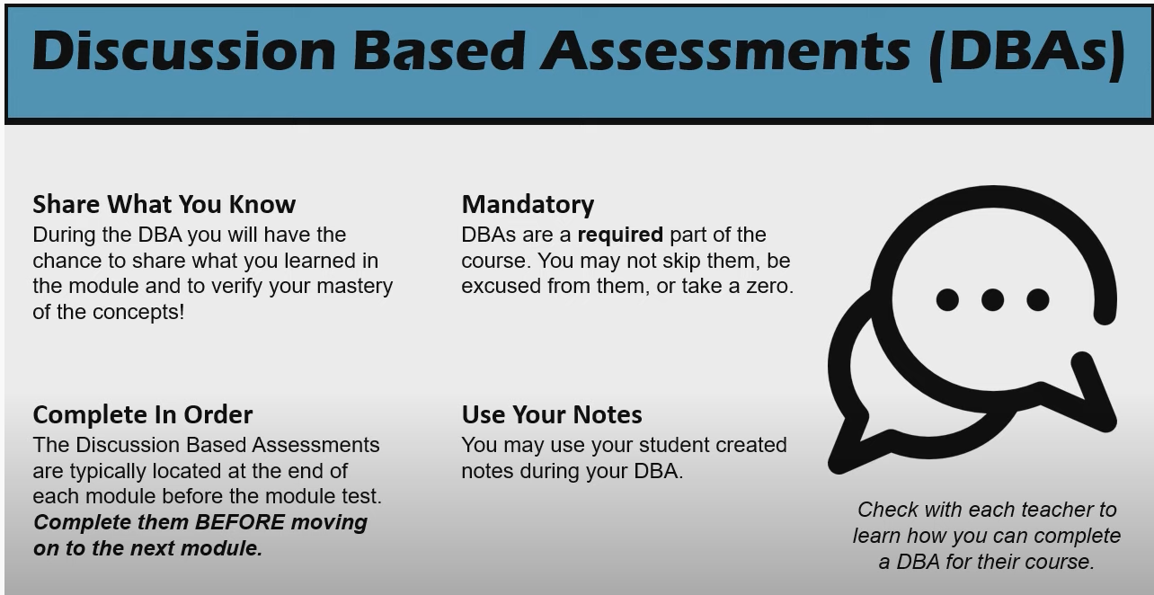

Discussion Based Assessments (DBAs)

Slide 46
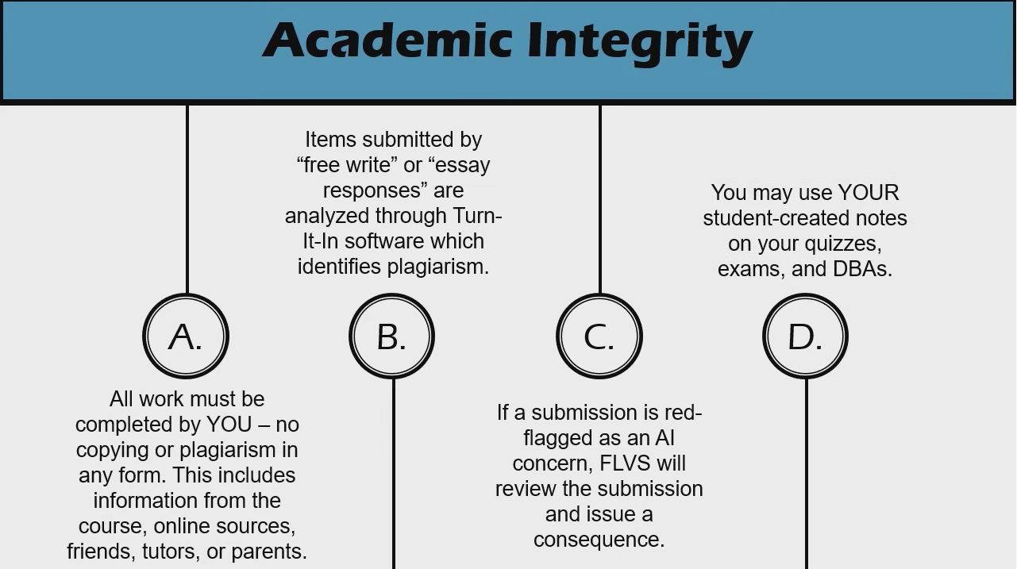

Academic Integrity

Slide 47
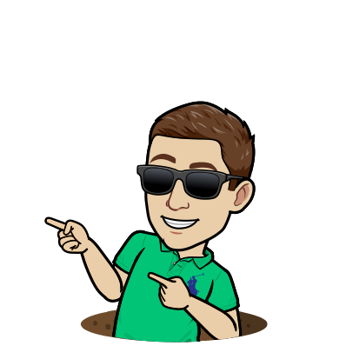
Student Expectations
Try your best
Read and take notes before submitting assignments
Follow the pace chart (be on or ahead of pace)
Complete assignments in order and on time
Maintain Academic Integrity
Review all grades and teacher feedback
Respond to teacher communication
Let your teacher know if you are having any difficulties

Slide 48
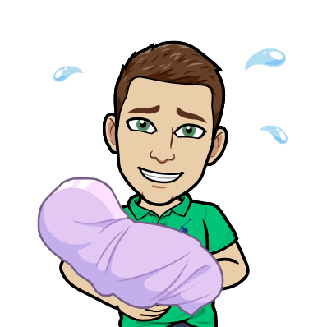
Parent Expectations
Two-way Communication with teacher
Bi-weekly Progress Reports
DBAs must be completed solely between teacher and student
Contact teacher with questions or concerns
Use your FLVS parent/guardian account (need to setup? Link found on SJVS website)
Encourage your student to stay on or ahead of pace., maintain academic integrity, and meet course requirements
Help with course navigation

Slide 49
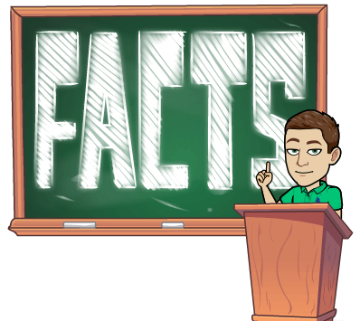
Tips for Virtual Success
Complete lessons daily
Follow the pace chart or go ahead
Attend live teacher time
Apply high standards and academic integrity to all coursework
Take notes
Ask for help
Utilize videos, resources, printables

Slide 50
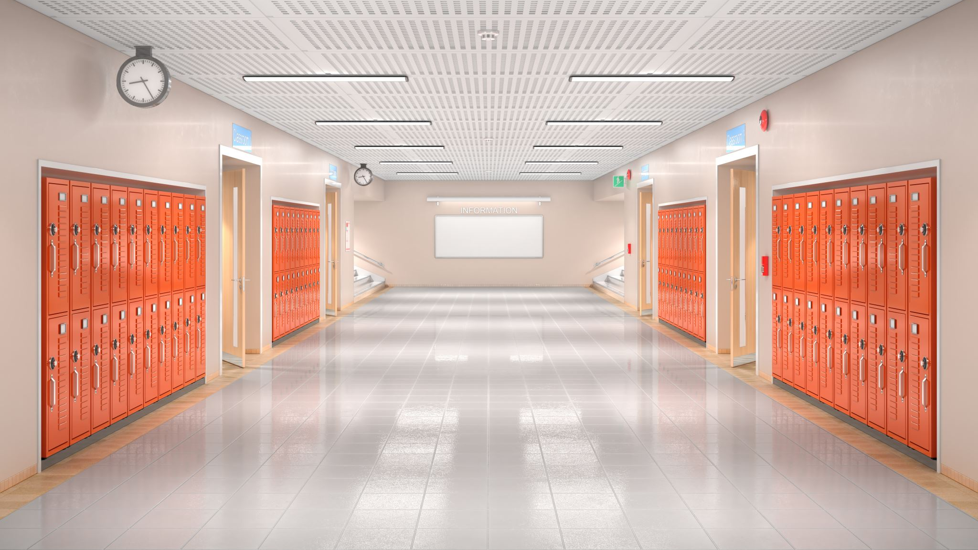
School Access

Slide 51
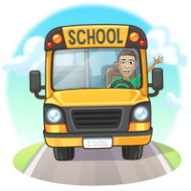
School Access
For the safety of the students and staff at St. Johns Virtual School, St. Johns County School District has a policy where all visitors must complete a volunteer online school access form which is good for three years. When doing so you are agreeing to a criminal background check and a sexual offender check. You are also agreeing to abide by the policies and procedures of the St. Johns County School Board and its facilities. The process can take two – six weeks to process your form. Please note that any individual not in the system and cleared, will not be allowed past the front lobby, no exceptions. Starting in 2025-2026, St. Johns County School District has moved to a new platform called Raptor Technologies.
Steps to complete:
Visit Page: Click Here
Complete District Volunteer Application

Slide 52
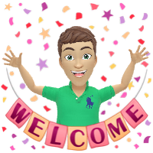
#RamFam

